Slide 1
Self-Organizing Maps
Project made by Dina George-Alexandru (333)

Slide 2
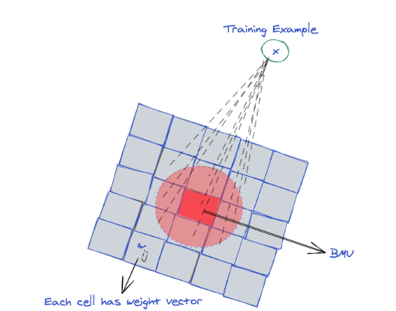
Introduction
A Self-Organizing Map was first introduced by Teuvo Kohonen in 1982 and is also sometimes known as a Kohonen map. It is a special type of an artificial neural network, which builds a map of the training data. The map is generally a 2D rectangular grid of weights but can be extended to a 3D or higher dimensional model. Other grid structures like hexagonal grids are also possible. ¹

Slide 3
It’s trained using competitive learning and operate in two modes:
Training, which uses an input data set (the "input space") to generate a lower-dimensional representation of the input data (the "map space")
Mapping, which classifies additional input data using the generated map.
A map space consists of components called "nodes" or "neurons", which are arranged as a hexagonal or rectangular grid with two dimensions. The number of nodes and their arrangement are specified beforehand based on the larger goals of the analysis and exploration of the data. Each node in the map space is associated with a "weight" vector, which is the position of the node in the input space. While nodes in the map space stay fixed, training consists in moving weight vectors toward the input data (reducing a distance metric such as Euclidean distance) without spoiling the topology induced from the map space.²

Slide 4
Best Matching Unit (BMU)
The best matching unit (BMU) is the cell of the SOM grid that is closest to the training example x. One method of finding this unit is to compute the Euclidean distance of x from the weight of each cell of the grid.
Observation!
- Euclidean distance is not the only possible method of selecting the BMU. An alternative distance measure or a similarity metric can also be used to determine the BMU, and choosing this mainly depends on the data and model you're building specifically. ¹

Slide 5
Algorithm
Consider w_{i,j}(t) the weight from an input layer unit I to a Kohonen layer unit j at the time t. W_{i,j} is initialized using random numbers. ³
Repeat until convergence or maximum epochs are reached:
- Shuffle the training examples
- For each training instance x
- Find the best matching unit(BMU)
- Update the weight vector of BMU and its neighboring cells. ²

Slide 6
Code example for a find_BMU() function: ¹
- This function takes as parameters the SOM grid and a training example x. It calculates the Euclidian distance between each cell weight and x and returns the coordinates of BMU (the cell with the minimum distance). ¹
def find_BMU(SOM,x):
distSq = (np.square(SOM - x)).sum(axis=2)
return np.unravel_index(np.argmin(distSq, axis=None), distSq.shape)

Slide 7
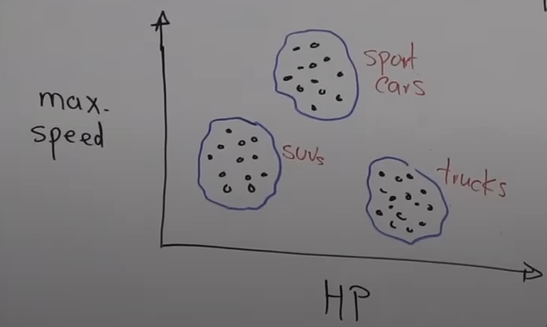
Clustering
The capability of grouping similar objects. It groups “unlabeled” data into “clusters” of similar inputs.
Example:
Clustering is unsupervised learning. It uses processing units (neurons) to place centroids on an adjustable map (SOM).
Hypothesis:
The model self-organizes based on learning rules and interactions. Processing units maintain proximity relationships as they grow. ⁴

Slide 8
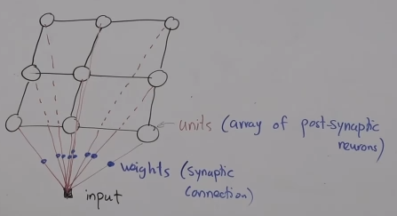
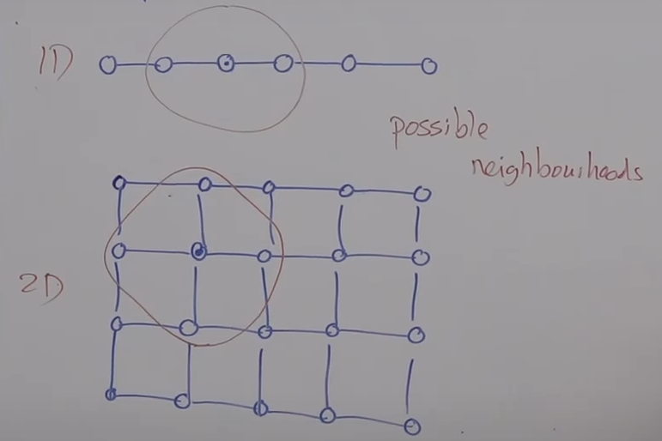
- Input is connected with each unit (neuron) of a lattice (map).
Example of SOM:
Concept of Neighborhood:

Slide 9
Goal:
Find weight values such that adjacent units have similar values.
- Inputs are assigned to units that are similar to them.

Slide 10
Bibliography
https://stackabuse.com/self-organizing-maps-theory-and-implementation-in-python-with-numpy/
https://en.wikipedia.org/wiki/Self-organizing_map
https://www.latentview.com/blog/self-organizing-maps/
https://www.youtube.com/watch?v=lFbxTlD5R98

